Slide 1
FY 24 - Way forward - Tippers

Slide 2


Key highlights
What went right
What went wrong
13% MS growth in Retail MS
Key competition customers taken to AL fold
Team synergy
Product establishment – 8x4 Tipper
Unfavorable TIV mix (11% in 10x4 Tipper)
Non availability of EDPTO ( Sold 40 no's)
Reliability issues on 8x4 Tippers
In-house finance funding availability

Slide 3
Heat Map - FY 23
Segment | Poonamalle |  |  | Madhavaram |  |  | Padappai |  |  | Vellore |  |  | Villupuram |  |  | Pondicherry |  |  | AO Chennai
4x2 Tipper | 26.7 |  |  | 5.3 |  |  | 14.7 |  |  | 22.7 |  |  | 12.0 |  |  | 18.7 |  |  | 100.0
 | 30.0 |  |  | 50.0 |  |  | 27.3 |  |  | 64.7 |  |  | 88.9 |  |  | 92.9 |  |  | 57.3
 |  |  | 2.2 |  |  | 1.1 |  |  | 1.6 |  |  | 6.9 |  |  | 2.8 |  |  | 11.2 |  |  | 2.8
6x4 Tipper | 35.4 |  |  | 7.5 |  |  | 29.8 |  |  | 12.1 |  |  | 10.6 |  |  | 4.7 |  |  | 100.0
 | 42.8 |  |  | 24.1 |  |  | 35.8 |  |  | 42.1 |  |  | 48.8 |  |  | 13.0 |  |  | 38.5
 |  |  | 45.2 |  |  | 24.6 |  |  | 48.9 |  |  | 57.1 |  |  | 37.6 |  |  | 43.2 |  |  | 43.5
8x4 Tipper | 32.6 |  |  | 20.7 |  |  | 21.8 |  |  | 5.2 |  |  | 16.0 |  |  | 3.7 |  |  | 100.0
 | 44.9 |  |  | 78.7 |  |  | 35.2 |  |  | 42.4 |  |  | 48.9 |  |  | 23.8 |  |  | 49.5
 |  |  | 40.7 |  |  | 66.4 |  |  | 34.9 |  |  | 24.1 |  |  | 55.7 |  |  | 33.6 |  |  | 42.5
10x2 Tipper | 36.7 |  |  | 9.4 |  |  | 34.7 |  |  | 9.8 |  |  | 4.4 |  |  | 5.1 |  |  | 100.0
 | 40.4 |  |  | 53.6 |  |  | 20.4 |  |  | 75.9 |  |  | 38.5 |  |  | 0.0 |  |  | 36.0
 |  |  | 12.0 |  |  | 7.9 |  |  | 14.6 |  |  | 11.8 |  |  | 4.0 |  |  | 12.0 |  |  | 11.1
Tipper Total | 34.1 |  |  | 13.3 |  |  | 26.5 |  |  | 9.2 |  |  | 12.3 |  |  | 4.7 |  |  | 100.0
 | 43.1 |  |  | 63.0 |  |  | 33.2 |  |  | 47.8 |  |  | 49.5 |  |  | 24.0 |  |  | 43.4
 |  |  | 100.0 |  |  | 100.0 |  |  | 100.0 |  |  | 100.0 |  |  | 100.0 |  |  | 100.0 |  |  | 100.0
* Top Left corner - Sub-segment contribution within zone
* Bottom right corner - Zone contribution within sub-segment

Slide 4

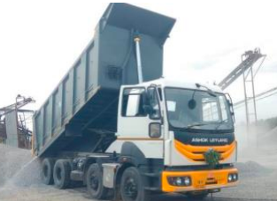
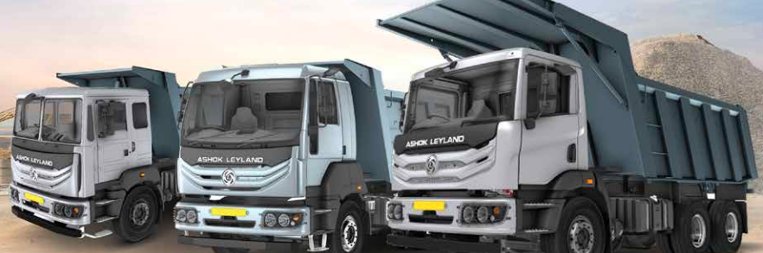
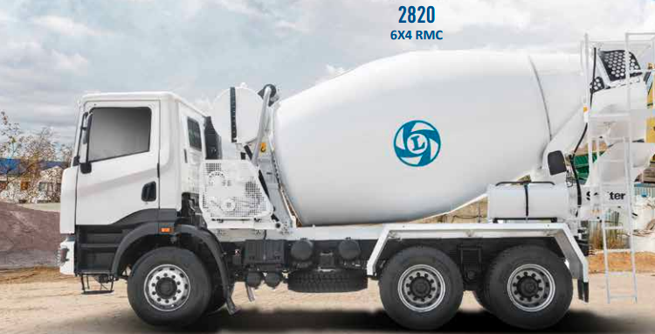
Market Map | FY (2023-24)
2700
1415
52%
3
2
1

Slide 5
Branch wise – Plan FY 24
FY 24 Plan | PME |  |  | MDVM |  |  | PDP |  |  | Chennai Total
 | AL | TIV | MS | AL | TIV | MS | AL | TIV | MS | AL | TIV | MS
4x2 Tipper | 10 | 20 | 50% | 3 | 5 | 60% | 5 | 10 | 50% | 18 | 35 | 51%
6x4 Tipper | 190 | 430 | 44% | 35 | 65 | 54% | 120 | 320 | 38% | 345 | 815 | 42%
8x4 Tipper | 200 | 320 | 63% | 185 | 250 | 74% | 110 | 220 | 50% | 495 | 790 | 63%
10x4 Tipper | 60 | 130 | 46% | 25 | 35 | 71% | 50 | 160 | 31% | 135 | 325 | 42%
Tipper Total | 460 | 900 | 51% | 248 | 355 | 70% | 285 | 710 | 40% | 993 | 1965 | 51%
FY 24 Plan | VELLORE |  |  | VPM |  |  | Pondy |  |  | TN 2
 | AL | TIV | MS | AL | TIV | MS | AL | TIV | MS | AL | TIV | MS
4x2 Tipper | 15 | 20 | 75% | 13 | 15 | 87% | 8 | 10 | 80% | 54 | 80 | 68%
6x4 Tipper | 60 | 130 | 46% | 85 | 140 | 61% | 28 | 55 | 51% | 518 | 1140 | 45%
8x4 Tipper | 45 | 65 | 69% | 100 | 180 | 56% | 20 | 45 | 44% | 660 | 1080 | 61%
10x4 Tipper | 25 | 40 | 63% | 13 | 20 | 65% | 10 | 15 | 67% | 183 | 400 | 46%
Tipper Total | 145 | 255 | 57% | 211 | 355 | 59% | 66 | 125 | 53% | 1415 | 2700 | 52%

Slide 6
Action Plan – 6x4 Tipper
Application | Area to focus /Hubs | Action Plan | Timeline | Responsibility
Sand/ M Sand | TN Govt .approved Sand mines Thiruvallur -4 ,Villupuram –7 ,Cuddalore - 3, Kanchipuram - 6, Arcot – 4, Vaniyambadi- 3 | Seeded M 2820 - 5 nos , KMPL needs to be established. Product establishment - user trials and testimonials (U 2820 & M 2820) Association based engagement | 31st Jul | TSM / ASM - Sales
RMC | Chennai –Bangalore Express Highway Chennai metro Phase 3 Ennore – Madhuravoyal flying bridge | Plant visit to major hirer operators in RMC Cargo RMC product needs to Established EDPTO mini launch | 31th Jun | TSM / ASM - Sales
Road construction | 6 way project on existing Chennai - Bangalore highway 8 way project on Chennai - Trichy Highway | Continuous engagement with associations Plant visit for major customers (Class 1 Contractors) Road shows and Tipper parade to be done. | 31th Jun | TSM / ASM - Sales
Blue metals | OSE project in Cuddalore Infra projects in Chennai | KMPL establishment – BB vs AL for major competition customers. Tipper Thiruvizha at various location to increase the visibility in market. | 30th Sep | ASM - Service TSM/ASM - sales
Boulders | New Mines approval expected in Q2. (Kanchipuram , Thiruvannamalai) | To seed N 2825 SR for Shallow mining and N 2825 HR for deep mining Capitalize N 2825 tipper for user trials. | 31th Jun | ASM / AM

Slide 7
Action Plan – 8x4 Tipper
Application | Location | Action Plan | Timeline | Responsibility
Road construction | Ennore – Madhuravoyal flying bridge. 6 way project on existing Chennai - Bangalore Highway. 8 way project on Chennai - Trichy Highway | Continuous engagement with associations. (Redhills , SP Koil assn) Tipper Thiruvizha to be done at various locations (Cuddalore, Pondicherry and SP koil) Product performance establishment – TML vs AL (Neyveli , Cuddalore , Redhills and SP koil) Video testimonial collections | 30th Jun | TSM/ ASM – sales
Blue metals | OSE project in Cuddalore. Infra projects in Chennai surroundings . Chennai Metro projects phase 3. | Continuous engagement with key competition customers. (SSK , SPR , DAP, AJS Infra) KMPL establishment to bridge the Price gap Back to back trial/Testimonials | 31st Jul | ASM - Service TSM /ASM - sales
Boulders | New Mines approval expected in Q2 (Kanchipuram, Thiruvannamalai) | Seeded 10 nos N 3525 in mining application need to establish the product performance. | 31st Jul | ASM – Service

Slide 8
Action Plan – 10x4 Tipper
Application | Location | Action Plan | Timeline | Responsibility
Road construction | 6 way project on existing Chennai - Bangalore Highway. 8 way project on Chennai - Trichy Highway | Continuous engagement with associations. (Redkills , SP Koil assn) Product performance establishment – TML vs AL Video testimonial collections | 30th Jun | TSM/ ASM – sales ASM - Service
Blue metals | Singaara Chennai – 2.0 Infra projects in Chennai surroundings . Chennai Metro projects phase 3. | Continuous engagement with key competition customers. (AGR, SPR , AJS Infra) KMPL establishment to bridge the Price gap (AGR and KGS) Back to back trial/Testimonials | 31st Jul | ASM - Service TSM /ASM - sales

Slide 9
Competition customer acquisition
Sl.No | Customer Name | Location | Fleet size | Purchase Plan FY 24 | Comptition | Segment | Action plan
1 |  | Tambaram | 250 | 50 | BB | 6x4 /8x4 | KMPL trial, Top management engagement
2 | SPR Blue metals | Pondicherry | 125 | 30 | TML | 8x4 | B2B user trial , Finance support
3 | AGR Group | SP Koil | 150 | 50 | TML | 8x4 /10x4 | Product establisment - U 4825 H6 4V , After market support
4 | Ganesh Blue metals | Kanchipuram | 50 | 20 | VECV / BB | 6x4 | B2B user trial , Service support
5 | Yes Traders | Arcot | 80 | 40 | BB | 6x4 | Continuous engagement with customer
6 | Anukulas Infra | Vellore | 60 | 20 | BB | 6x4 | B2B user trial , Continuous engagement with customer
7 | SPL Infra | Alwarpet | 120 | 20 | TML | 6x4 /8x4 | Continuous engagement with customer
8 | Varadhaman Infra | Poonamalle | 75 | 20 | BB | 8x4 /10x4 | B2B user trial , Service support
9 | Elan minerals | T Nager | 80 | 30 | TML | 6x4 /8x4 | Continuous engagement with customer
10 | SSK Blue metals | Pondicherry | 70 | 20 | TML | 8x4 | B2B user trial , Finance support

Slide 10
Top potential customers
Sl.No | Customer Name | Application | Segment | Fleet size | Likely purchase for FY 24 | SPOC | Customer type | Action Plan | Timeline
1 | Gummidipundi assn customers | Blue metals | 8x4 Tip | 400 | 100 | Ashok | Switcher | ASC required at Minjur area , Vehicle park will be 500 nos | Jul
2 | Madras assn customers | Blue metals | 8x4 Tip | 300 | 50 | Ashok | Switcher | Continuous engagement with customer. | Jul
3 | TNSLOA | Blue metals / Road construction | 6x4 Tip 8x4 Tip | 250 | 40 | Ashok | Switcher | Plant visit and Continuous engagement with customer. | Aug
4 | Roy & Co association customer | Blue metals / Boulders | 8x4 Tip 10x4 Tip | 150 | 30 | Ashok | AL Loyal | Plant visit and Continuous engagement with customer. | Nov
5 | RMC Retail customers | RMC | 6x4 Tip | 150 | 50 | Ashok | Switcher | KMPL establishment TML vs AL | Aug
6 | AGR Enterprises Group | Blue metals | 8x4 Tip 10x4 Tip | 300 | 80 | Sanjay | Switcher | U 4825 H6 4V model needs to established | Aug
7 | AJS Infra (Arupadai) | Blue metals / Boulders | 6x4 Tip 8x4 Tip | 280 | 50 | Sanjay | Competition loyal | Product establishment to be done in mining & surface applications (B2B trials) | Jul
8 | PS Blue metals | Blue metals / Boulders | 6x4 Tip 8x4 Tip | 270 | 40 | Sanjay | Switcher | After market support required . Frequent visit of service and parts team | Jun

Slide 11
Top potential customers
Sl.No | Customer Name | Application | Segment | Fleet size | Likely purchase for FY 24 | SPOC | Customer type | Action Plan | Timeline
9 | RS Enterprises | RMC | 6x4 Tip | 150 | 40 | Sanjay | Switcher | KMPL establishment TML vs AL | Jul
10 | Tambaram / Trisulam Assn | Blue metals | 8x4 Tip | 150 | 30 | Sanjay | Switcher | Plant visit and Continuous engagement with customer. | Aug
11 | SPR Blue metals | Blue metals | 8x4 Tip | 150 | 30 | George | Competition loyal | Product establishment to be done TML 3525 vs AL U 3525 (B2B trials). | Jul
12 | SSK Blue metals | Blue metals | 8x4 Tip | 80 | 20 | George | Competition loyal | Product establishment to be done TML 3525 vs AL U 3525 (B2B trials). | Jul
13 | ADR & Sembaiyanar | Blue metals | 8x4 Tip | 100 | 30 | George | AL Loyal | Plant visit and Continuous engagement with customer. | Sep
14 | Shanmugasundaram | Blue metals | 8x4 Tip | 100 | 25 | George | Switcher | Plant visit and Continuous engagement with customer. | Sep
15 | Om Sakthi | Blue metals / RMC | 6x4 Tip 8x4 Tip | 200 | 40 | George | Switcher | Plant visit and Continuous engagement with customer. | Sep

Slide 12
Support required
Comprehensive AMC package
EDPTO seeding support
Higher diameter clutch – 430 mm
ASC Required – Minjur and Vadalur
Dealer manpower needs to be added (PDP – 1 , PME – 1)

Slide 13
THANK YOU

